Slide 1
Enhancing EV Charging Performance with ANN-Controlled Solar/Wind Hybrid Systems

Slide 2
Contents
Abstract
Introduction
Literature Review
Existing Method
Drawbacks
Proposed Method
Extension Method
Block Diagram
Advantages
Applications
Simulation Results
Conclusion
References

Slide 3
Abstract
This project explores the enhancement of electric vehicle (EV) charging performance through the integration of an Artificial Neural Network (ANN) controller within a solar/wind hybrid power system.
The project focuses on designing a robust, efficient system that leverages the complementary nature of solar and wind energy sources to ensure a consistent and reliable power supply.
By incorporating ANN control strategies, the system dynamically adjusts to fluctuations in energy production and demand, optimizing the charging process for EVs.
The proposed hybrid system not only improves energy efficiency but also reduces dependency on the conventional grid, promoting sustainable and eco-friendly transportation solutions.
Simulation results demonstrate significant performance gains in terms of energy utilization and charging speed, highlighting the potential of ANN-controlled hybrid systems in advancing the EV charging infrastructure.

Slide 4
Introduction
Electric Vehicles (EVs) are reduce environmental pollution
But charging that EVs using power which is generating from renewable sources which are coal, nuclear energy etc.., which leads to environment pollution and global warming.
Designing a Hybrid power system which is generating power from Solar/Wind can reduce environmental pollution.
Hybrid RES combining solar photovoltaic (PV) and wind turbines have gained traction for their ability to provide a balanced energy output under varying weather conditions.
Traditional control methods often fail to optimize the utilization of renewable resources, leading to inefficiencies in energy distribution and higher operational costs
Recent advancements in artificial intelligence, particularly Artificial Neural Networks (ANNs), have demonstrated remarkable capabilities in optimizing nonlinear and complex systems.

Slide 5
ANNs, with their ability to learn and adapt to dynamic scenarios, can effectively manage energy flow in hybrid systems, maximizing power output while maintaining grid stability
This paper proposes an ANN-controlled solar/wind hybrid power system aimed at enhancing EV charging performance.
Showcasing its superiority in terms of energy efficiency and charging reliability over conventional methods.
This research contributes to the development of sustainable EV charging infrastructure by integrating intelligent control mechanisms into renewable energy systems, thus promoting a cleaner and greener transportation future.

Slide 6
Literature review
[1] Liserre, M., Sauter, T., & Hung,(2021). "Future energy systems: Integrating renewable energy sources into the smart power grid through industrial electronics". IEEE Industrial Electronics Magazine. (DC Microgrid-Based EV Charging Stations)
[2] Bansal, R. C., et al. (2024). "Application of ANN in smart grid and renewable energy systems". Renewable and Sustainable Energy Reviews.(Artificial Neural Network (ANN) in Power Systems)
[3] Kamel, R. M., & Chaouachi, A. (2022). "ANN-based coordinated control for EV fast charging stations integrated with microgrid". IEEE Transactions on Smart Grid. (Control Strategies for EV Fast Charging Using ANN)
[4] Guerrero, J. M., et al. (2022). "Hierarchical control of droop- controlled AC and DC microgrids—A general approach toward standardization". IEEE Transactions on Industrial Electronics.( Renewable Energy Integration )

Slide 7
Existing method
In Existing methods of charging electric vehicles primary on non-renewable energy sources. Even when renewable sources are used, they are often limited to either solar or wind energy individually, resulting in reduced system reliability.

Slide 8
Disadvantages of existing system
Less Reliability
Poor energy management without intelligent control
Power losses due to poor decision-making

Slide 9
Proposed method
In the proposed method, a hybrid system combining solar and wind energy is used to charge electric vehicles both during the day and at night, thereby increasing system reliability
In extension method we replace the PI Controller of Buck converter with ANN Controller For better Performance to charge the Electrical Vehicles.

Slide 10
ANN controller
The ANN in this system is trained to generate precise gate pulses for the buck converters, ensuring stable voltage and current delivery to the EVs.
The ANN's ability to adapt to real-time changes in load conditions significantly improves the reliability and robustness of the charging process.
when multiple EVs are connected for charging simultaneously, the ANN dynamically adjusts the duty cycles of the buck converters, balancing the load across all charging ports.

Slide 11
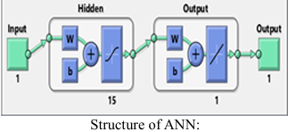
This intelligent control mechanism minimizes voltage ripples and energy losses, ensuring that each EV is charged efficiently without overloading the system.
The diagram represents a Function Fitting Neural Network

Slide 12
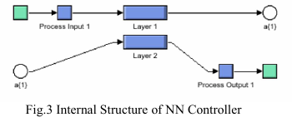
Advantages of ANN controller over PI controller
Enhances the hybrid system's performance by ensuring faster response times and superior control accuracy compared to conventional controllers.
This feature prevents overloading and ensures fair power distribution among the connected vehicles.
The Hybrid system at peak efficiency while maintaining the flexibility to adapt to real world challenges

Slide 13
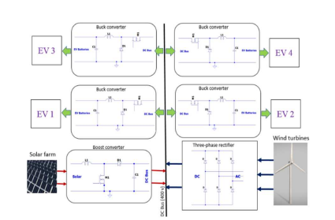
Block diagram
Fig. 1. Charging station block diagram

Slide 14
Advantages of proposed system
More Reliability
Zero Pollution
Less maintains
No Need for Exact Mathematical Model
Off-Grid / Remote Area EV Charging Systems
Renewable energy Generation System
Micro Grid System
EV Charging Applications.
Battery Management Systems (BMS)

Slide 15
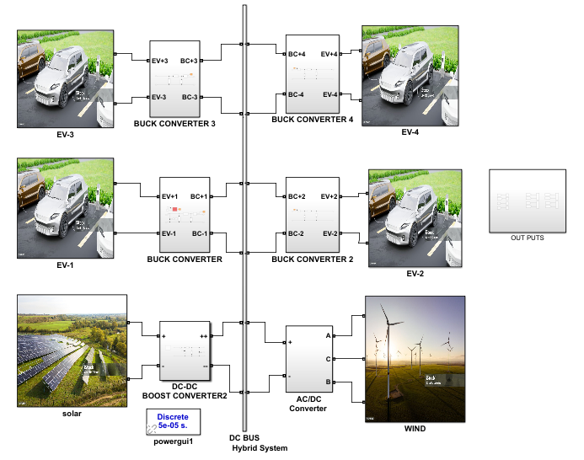
Simulation Results
Fig 1 Simulation Diagram of proposed System.

Slide 16
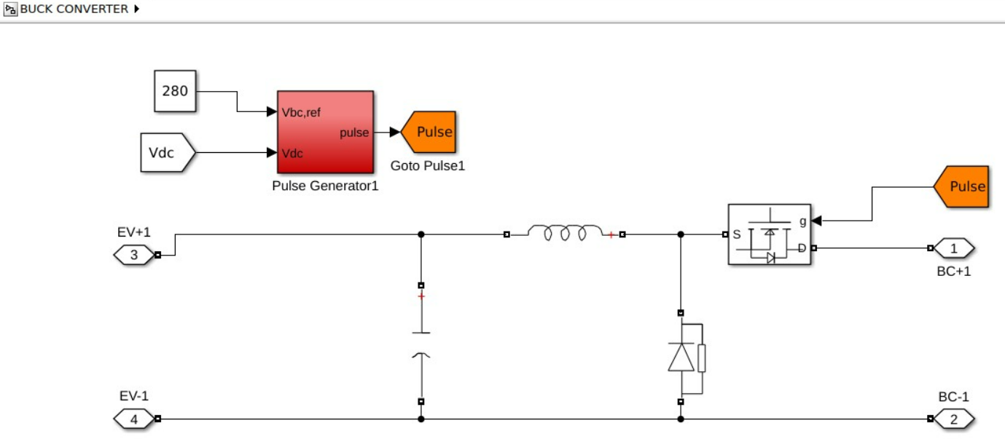
Schematic in simulation
BUCK CONVERTER WITH ANN CONTROLLER

Slide 17
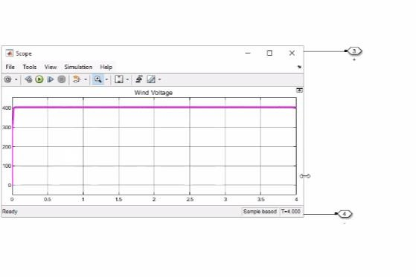
Ac to dc converter ouput

Slide 18
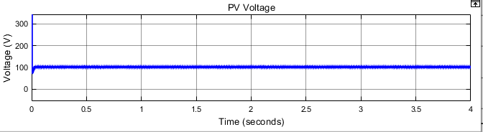
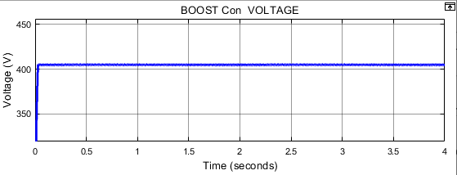
2(a) Solar Out Put
2(b) Boost converters Out Put

Slide 19
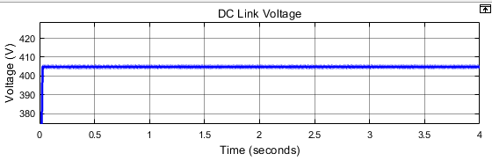
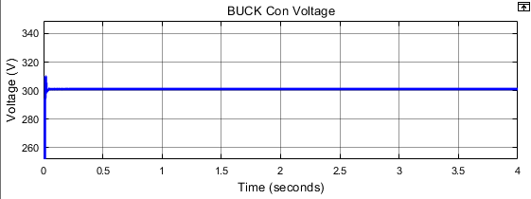
3(a) DC link Voltage
3(b) Buck Converter Voltage

Slide 20
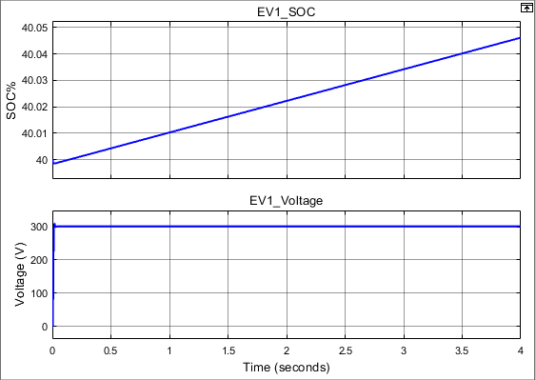
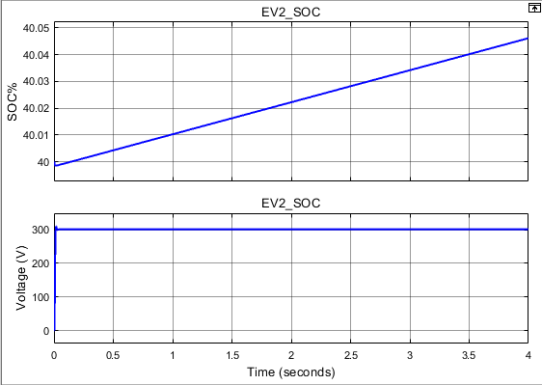
Fig5 EV2 Out Puts
Fig4 EV1 Out Puts

Slide 21
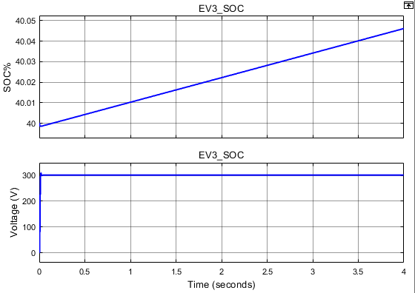
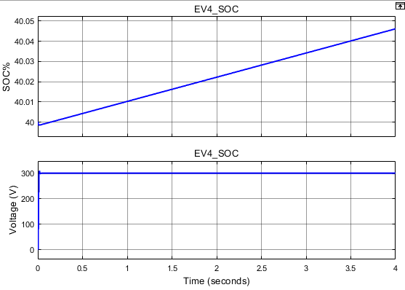
Fig6 EV3 Out Puts
Fig7 EV4 Out Puts

Slide 22
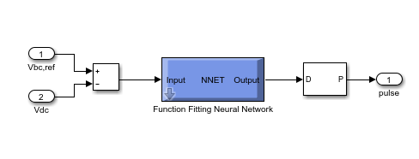
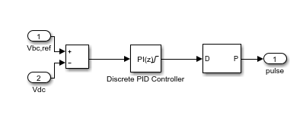
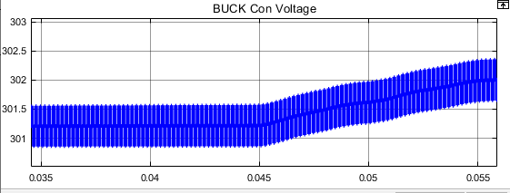
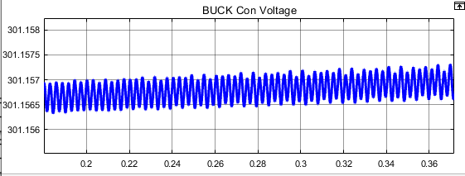
Fig 9 Buck converter Controller with PI Control.
Fig 2 Buck converter Controller with ANN Control.
Fig 10 Zoomed results of Electrical Vehicle Battery Voltage with Buck converter Controlled by PI Controller
Fig 11 Zoomed results of Electrical Vehicle Battery Voltage with Buck converter Controlled by ANN Controller

Slide 23
Conclusion
The design of a solar/wind hybrid power system for charging electric vehicles presents a sustainable and efficient solution to meet the growing demand for clean energy in transportation.
This system leverages the complementary nature of solar and wind resources, ensuring a more reliable and continuous power supply.
By integrating these renewable energy sources, the proposed hybrid system not only reduces dependence on fossil fuels but also minimizes environmental impact.
This approach not only supports the transition to green energy but also provides a scalable and adaptable framework for future advancements in renewable energy technology and electric vehicle infrastructure.

Slide 24
Future research
Improve Controller Performance:
Future work can focus on replacing ANN controllers with intelligent controllers such as ANFIS to improve system performance
Add More Renewable Sources
Add Fuel cell, Biogas they Make system more reliable
Battery Optimization controller
Improve battery usage
Avoid overcharging and deep discharge
Battery management strategies can be improved to increase battery life and efficiency.

Slide 25
References
[1] V. Khare, S. Nema, and P. Baredar, "Solar–wind hybrid renewable energy system: A review," Renewable and Sustainable Energy Reviews, vol. 58, pp. 23-33, 2016.
[2] L. Khalvati and L. Khalvati, "Estimating Potential Solar Energy With Three Different Architecture Designs Using Crystalline Silicon Modules."
[3] A. Balal and M. Giesselmann, "PV to Vehicle, PV to Grid, Vehicle to Grid, and Grid to Vehicle Micro Grid System Using Level Three Charging Station," in 2022 IEEE Green Technologies Conference (GreenTech), 2022: IEEE, pp. 25-30.
[4] Y. Wu, Z. Liu, J. Liu, H. Xiao, R. Liu, and L. Zhang, "Optimal battery capacity of grid-connected PV-battery systems considering battery degradation," Renewable Energy, vol. 181, pp. 10-23, 2022.
[5] A. T. Balal, M. Abedi, and F. Shahabi, "Optimized generated power of a solar PV system using an intelligent tracking technique," 2021.

Slide 26
THANK YOU

